Slide 1
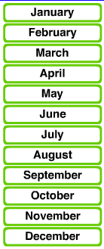
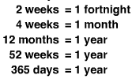
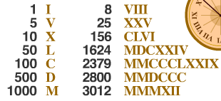
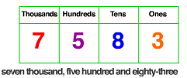
This year I would like to… ________________________________________________
Aa, Bb, Cc, Dd, Ee, Ff, Gg, Hh, II, Jj, Kk, Ll, Mm, Nn, Oo, Pp, Qq, Rr, Ss, Tt, Uu, Vv, Ww, Xx, Yy, ZZ
I am Uniquely Me…
1
2
3
4
5
6
7
8
9
10
11
12
13
14
15
16
17
18
19
20
________________________________________________
100cm = 1 m, 100om = 1 km, 1000ml = 1 L, 1000L = 1KL
________________________________________________
________________________________________________
________________________________________________
________________________________________________
________________________________________________
__________________________________
Favourite words of mine… ______
_______________
Wellsford School
10mm = 1cm
Room 6, 2015
Teacher: Mr L

