Slide 1
NumP Testing A

Slide 5
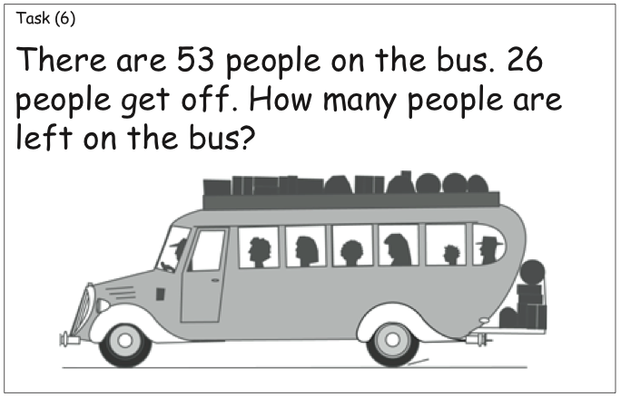

Slide 6
FWNS

Slide 7
5

Slide 8
9

Slide 9
13

Slide 10
19

Slide 11
12

Slide 12
15

Slide 13
29

Slide 14
46

Slide 15
69

Slide 16
80

Slide 17
139

Slide 18
899

Slide 19
BWNS

Slide 20
3

Slide 21
9

Slide 22
5

Slide 23
8

Slide 24
16

Slide 25
20

Slide 26
17

Slide 27
11

Slide 28
13

Slide 29
31

Slide 30
47

Slide 31
70

Slide 32
236

Slide 33
600

Slide 34
Number ID

Slide 35
3

Slide 36
9

Slide 37
5

Slide 38
1

Slide 39
8

Slide 40
6

Slide 41
0

Slide 42
4

Slide 43
2

Slide 44
7

Slide 45
10

Slide 46
13

Slide 47
19

Slide 48
11

Slide 49
16

Slide 50
12

Slide 51
66

Slide 52
43

Slide 53
80

Slide 54
38

Slide 55
137

Slide 56
702

Slide 57
Place Value

Slide 59
Basic Facts

Slide 60
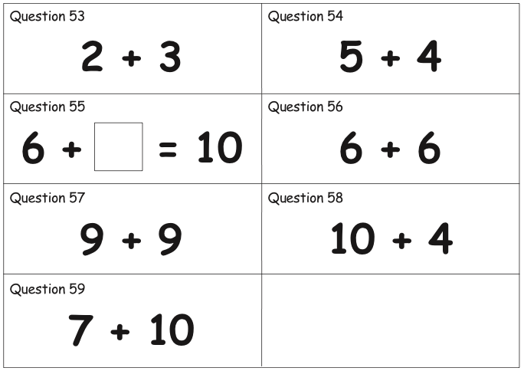

Slide 61
NumP Testing B

Slide 66
Multiplication / Division

Slide 67
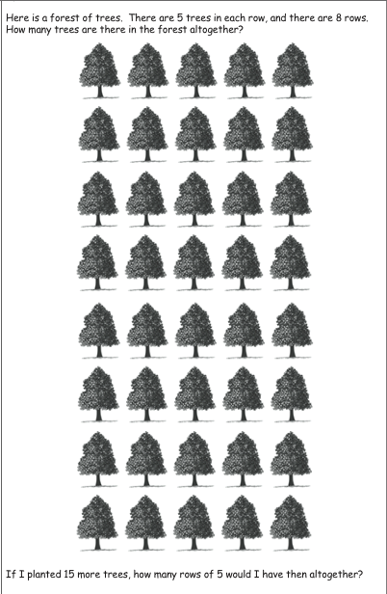

Slide 68
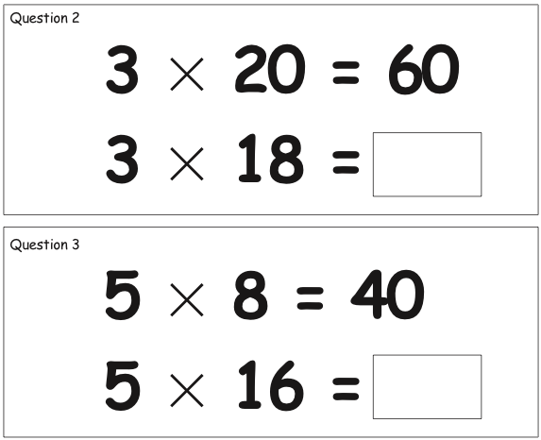

Slide 69
Proportions and Ratios

Slide 70
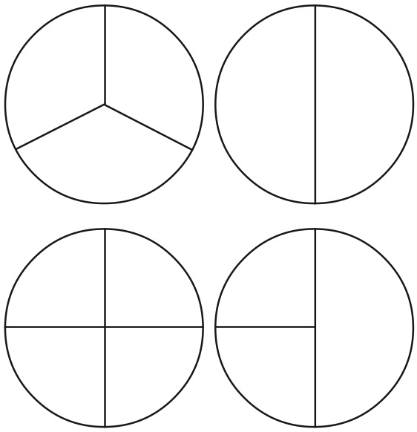

Slide 72
FWNS

Slide 73
12

Slide 74
17

Slide 75
29

Slide 76
99

Slide 77
209

Slide 78
999

Slide 79
3 049

Slide 80
989 999

Slide 81
BWNS

Slide 82
13

Slide 83
19

Slide 84
30

Slide 85
100

Slide 86
680

Slide 87
900

Slide 88
2 400

Slide 89
603 000

Slide 90
Fractions

Slide 91
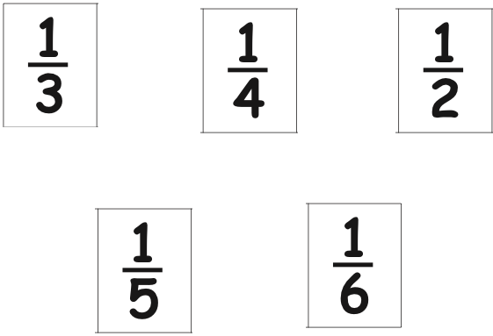

Slide 92
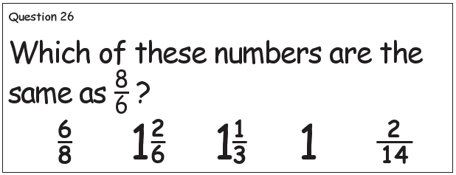

Slide 93
Place Value

Slide 94
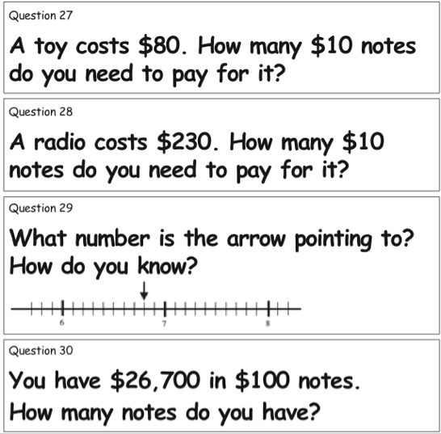

Slide 95
Basic Facts

Slide 96
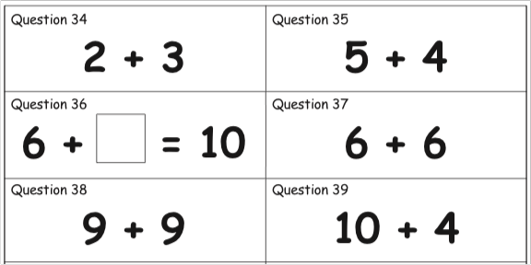

Slide 97
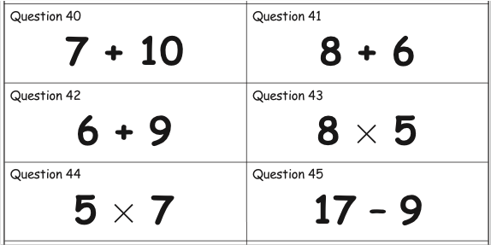

Slide 98
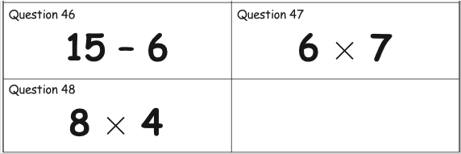

Slide 99
NumP Testing C

Slide 101
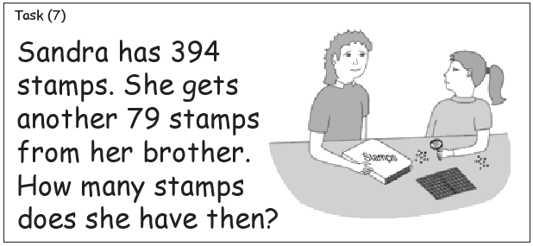

Slide 102
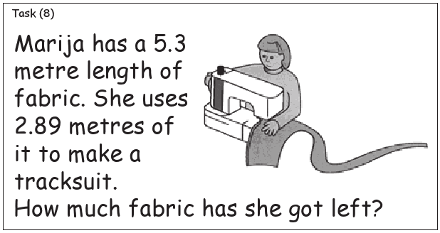

Slide 103
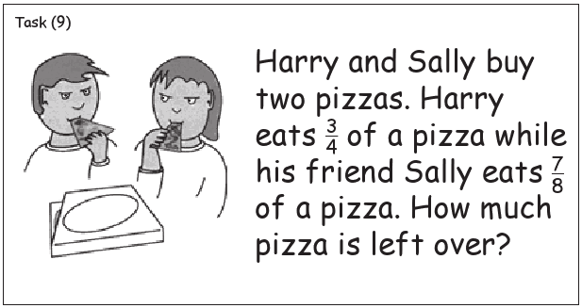

Slide 104
Multiplication / Division

Slide 107
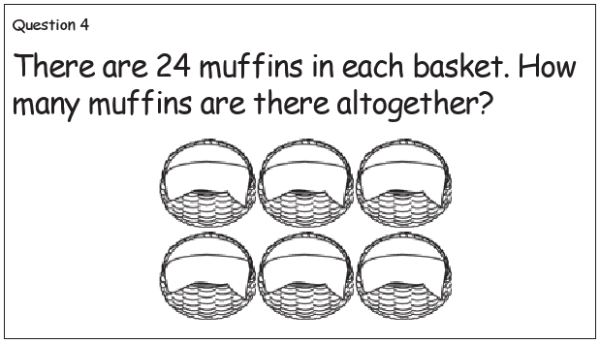

Slide 108
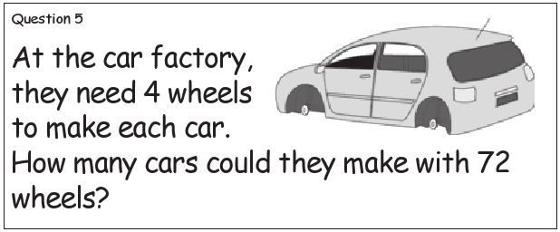

Slide 109
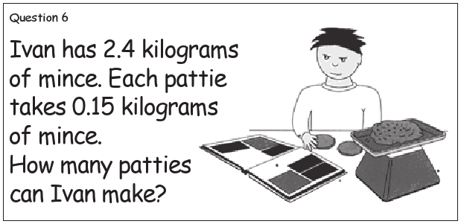

Slide 110
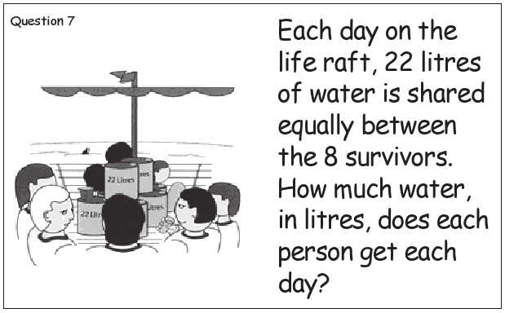

Slide 111
Proportions and Ratios

Slide 115
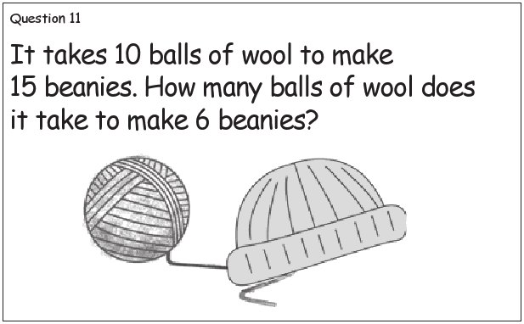

Slide 117
FWNS / BWNS

Slide 118
2 400

Slide 119
3 049

Slide 120
603 000

Slide 121
989 999

Slide 122
Fractions

Slide 124
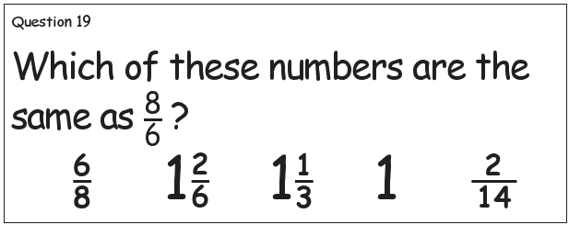

Slide 126
Place Value

Slide 127
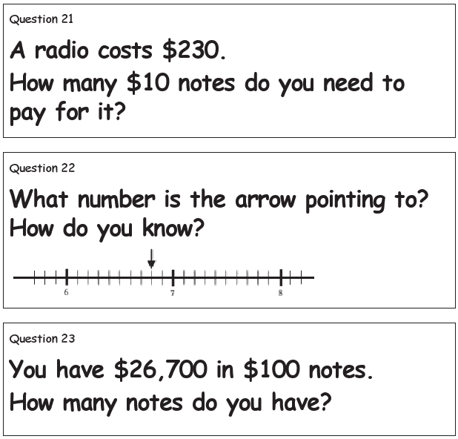

Slide 128
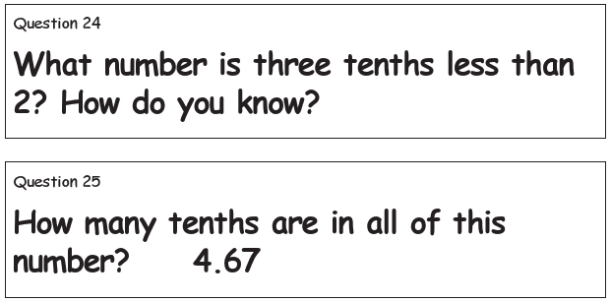

Slide 129
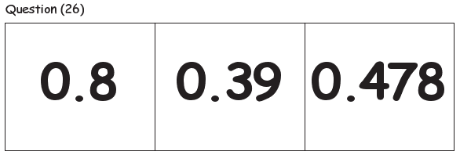

Slide 130
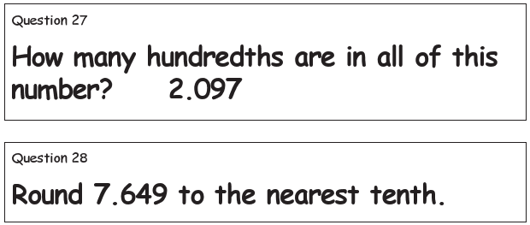

Slide 131
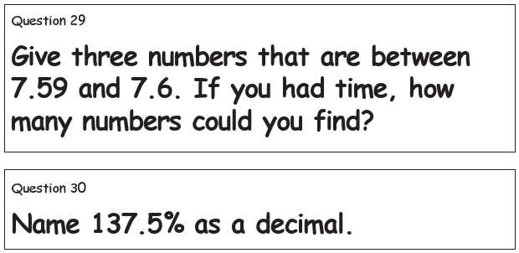

Slide 132
Basic Facts

Slide 133
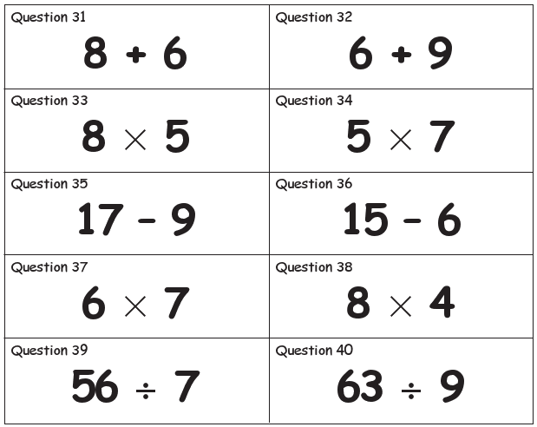

Slide 134
