Slide 1
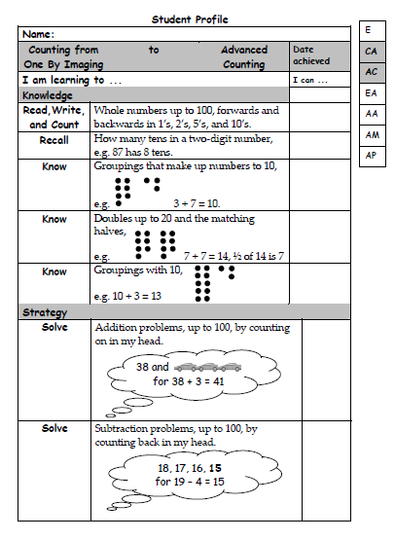
Date: _________ Numeracy Goals
My Addition Stage is: ______________
My goal is to move to stage __________
These are the skills I need to achieve….
Date: _________ Numeracy Goals
My Addition Stage is: ______________
My goal is to move to stage __________
These are the skills I need to achieve….

Slide 2
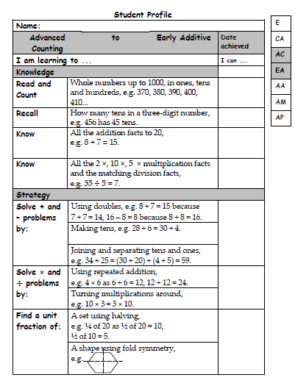
Date: _________ Numeracy Goals
My Addition Stage is: ______________
My goal is to move to stage __________
These are the skills I need to achieve….
Date: _________ Numeracy Goals
My Addition Stage is: ______________
My goal is to move to stage __________
These are the skills I need to achieve….

Slide 3
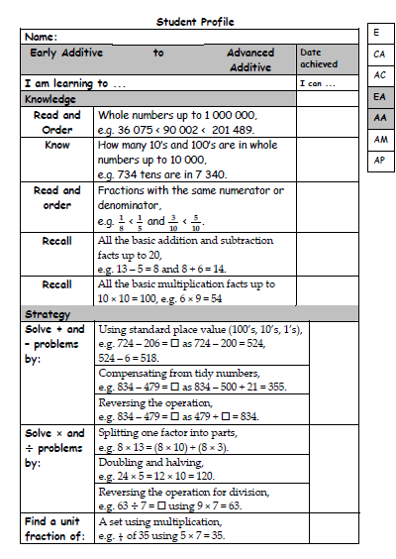
Date: _________ Numeracy Goals
My Addition Stage is: ______________
My goal is to move to stage __________
These are the skills I need to achieve….
Date: _________ Numeracy Goals
My Addition Stage is: ______________
My goal is to move to stage __________
These are the skills I need to achieve….

Slide 4
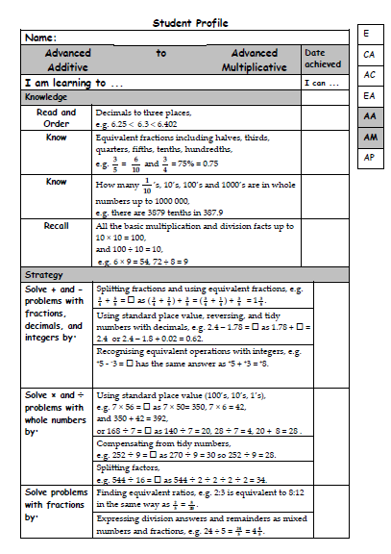
Date: _________ Numeracy Goals
My Addition Stage is: ______________
My goal is to move to stage __________
These are the skills I need to achieve….
Date: _________ Numeracy Goals
My Addition Stage is: ______________
My goal is to move to stage __________
These are the skills I need to achieve….

Slide 5
Date: _________ Numeracy Goals
My Addition Stage is: ______________
My goal is to move to stage __________
These are the skills I need to achieve….
Date: _________ Numeracy Goals
My Addition Stage is: ______________
My goal is to move to stage __________
These are the skills I need to achieve….

