Slide 2
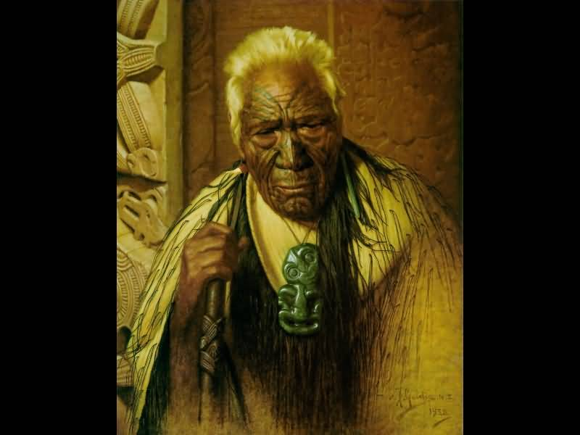
A Tohunga would perform a karakia. This was to acknowledge the new year and remember those who had passed away. Tohunga would gather up young shoots of kumara and other plants which would be burnt and offered to Matariki. If the stars were clear and bright it meant that it would be a warm and bountiful season. If they were dull and hazy it would be a cold and difficult season and the crops would be scarce.
The role of a Tohunga was to make sure tikanga was followed when food was gathered. Tohunga guided and protected the people.

Slide 3
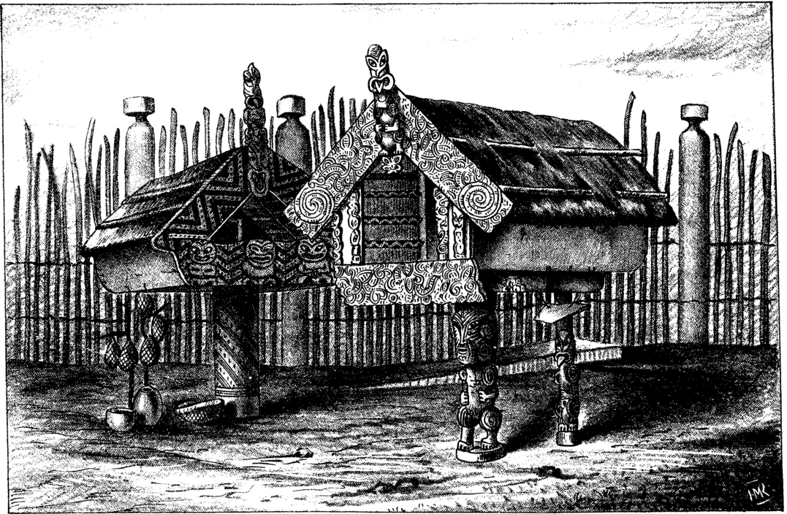
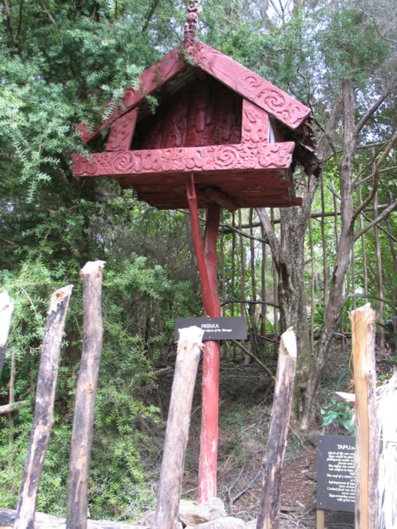
Pātaka (storehouses)
Pātaka kai were used to store food. They were built on smooth stilts so that rats and other scavengers couldn’t get in and eat all the food.

Slide 4
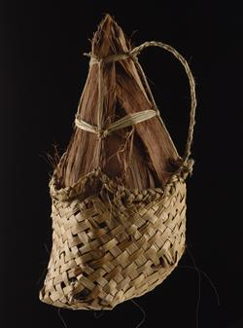
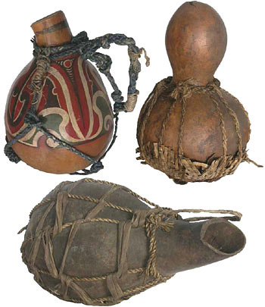
Kererū, eels, and native rats were caught and preserved in fat and placed in pōhā (kelp bags) or hue (gourds).
These were preserved for the winter months ahead.
‘Ka kitea a Matariki, ka maoka te hinu’
When Matariki is seen the fat is cooked

Slide 5
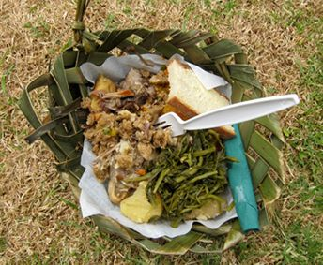
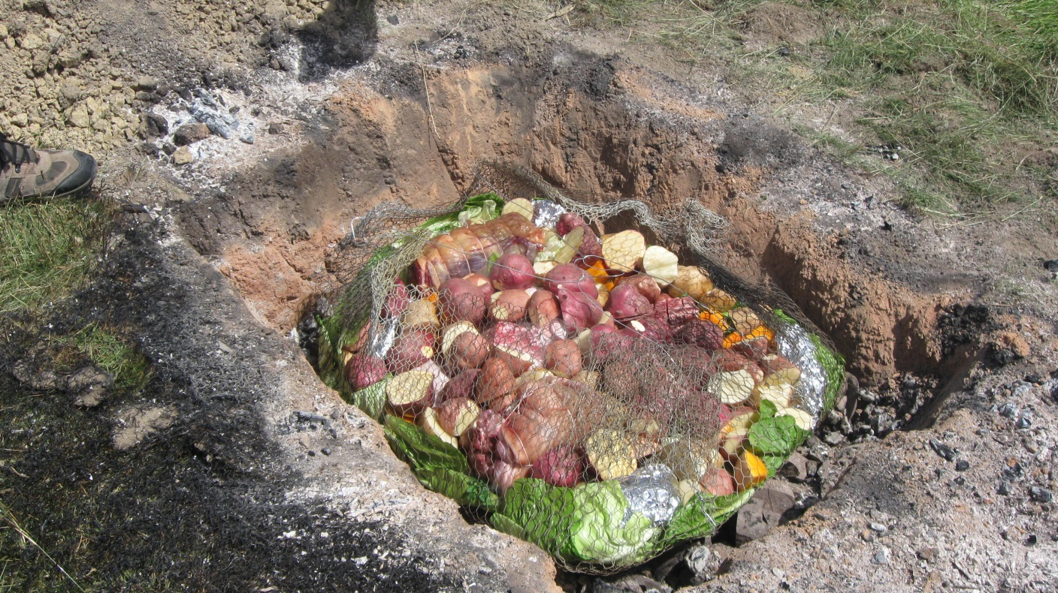
The Pātaka were full and a feast was held. A Hāngī fed all the people that came to celebrate.

Slide 6
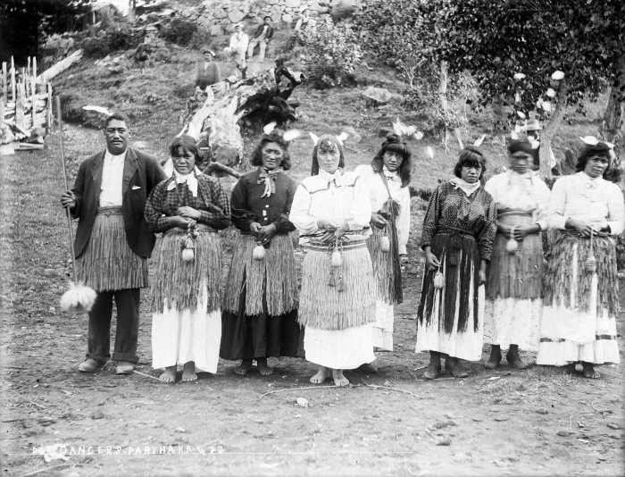
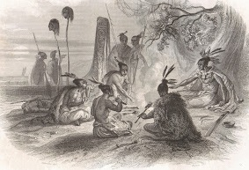
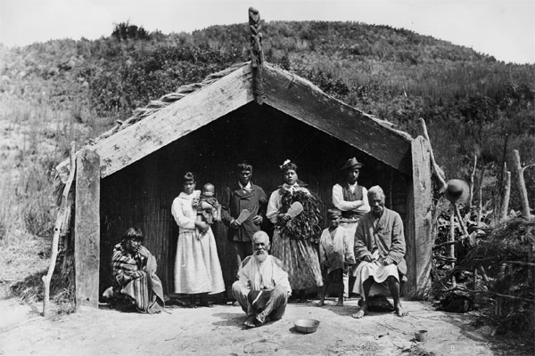
People gathered together to remember the past and plan for the future. They remembered those who had passed on and the legacy the left behind. Tribal traditions were passed down and they learnt more about their whakapapa.

Slide 7
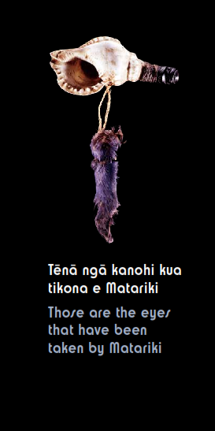
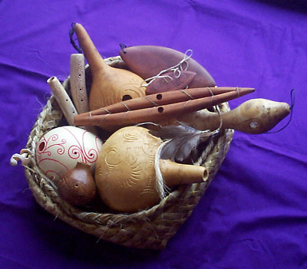
Pūtātara (conch shells) were used to signal the rise of Matariki.
Pūrerehua and porotiti are instruments that use the voice of Tāwhirimātea because they are swung through the air in a whirling motion. These were used to celebrate Matariki. The calming sound helped the children to be more focused on their learning.

Slide 8
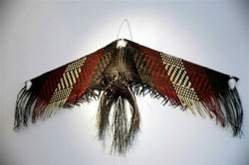
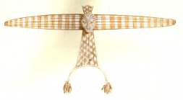
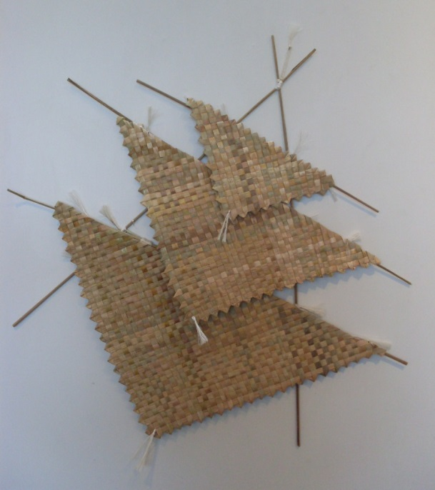
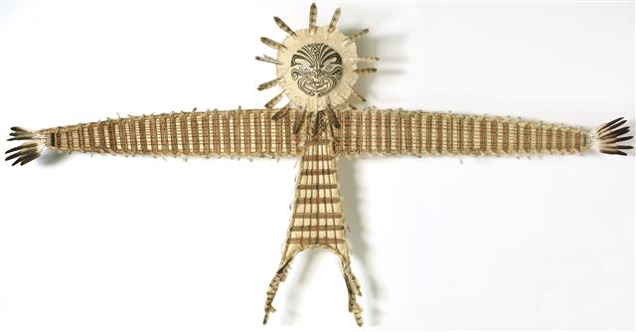
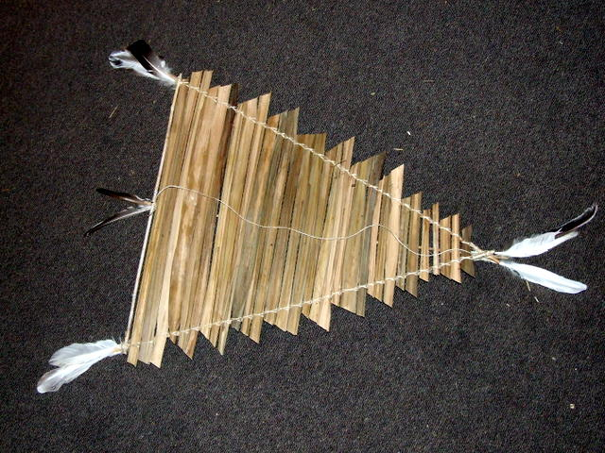
Kite flying was popular with ancient Maori and used particularly during Matariki. Kites were believed to make a spiritual connection with the gods.
Nowadays, The Manu Aute Kite Day is part of the Matariki (Maori New Year) celebrations at Orakei Marae in Auckland.

Slide 9
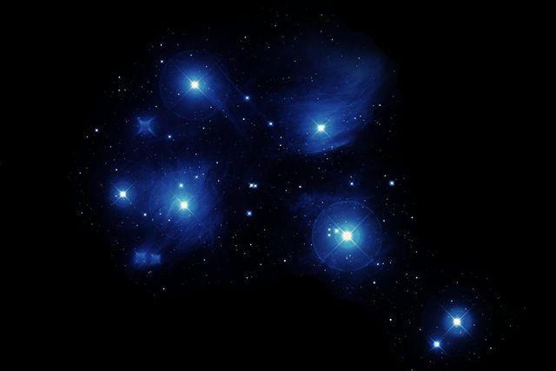
I te wä o Matariki, ka whakanui tätou i tö tätou mana motuhake i tënei ao.
He manaaki i te whenua e noho nei tätou i runga, he mïharo ki tö tätou whaea,
ki a Papatüänuku. I te roanga atu o Matariki, ka ako tätou i ngä ähuatanga ö rätou mä
kua hoki ki te käinga tüturu. Ko ngä mahi me ngä körero o mua. Ko ö tätou heke. Ko ö tätou wheinga. Ko Matariki te tohu o te tupu. He wä e puta kë ai. He wä whakariterite, he wä kökiri kaupapa. I te wä o Matariki, he mahara atawhai ki ngä taonga kei a tätou inaianei,
hei koha atu hoki a taihoa. He whakanui a Matariki i ngä tini ähuatanga o te oranga.
He whakanui hoki i te tikanga, i te reo, i te wairua me te iwi.
Ko Matariki tö Aotearoa tau hou.
During Matariki we celebrate our unique place in the world. We give respect to the whenua on which we live, and admiration to our mother earth Papatūānuku.
We learn about those who came before us.
Our history. Our family. Our bones.
Matariki signals growth. It’s a time of change.
It’s a time to prepare, and a time of action.
We acknowledge what we have and what we have to give.
Matariki celebrates the diversity of life.
It’s a celebration of culture, language, spirit and people.
Matariki is our Aotearoa Pacific New Year.

