Slide 1
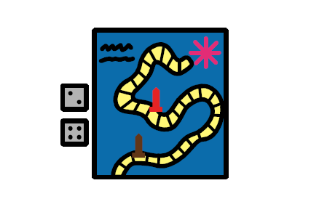
I am learning that it is ok to lose and not be chosen when playing games.

Slide 2
I like to play games and I like to win!

Slide 3
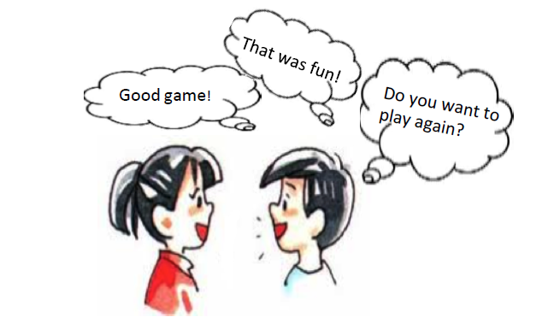
When I win, I feel happy and I often say nice things to my friends.

Slide 4
Sometimes I lose. I don’t like to lose. When I lose, I feel very mad.

Slide 5
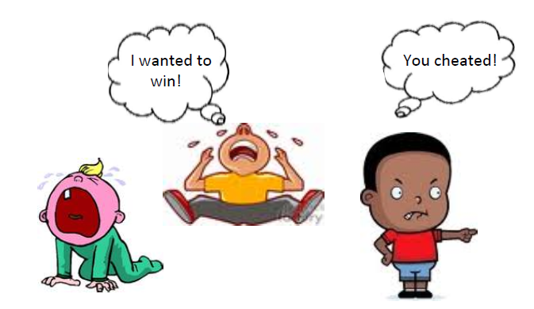
When I lose, sometimes I cry, whine and say mean things to my friends.

Slide 6
When I get angry, it makes the winner of the game sad. My friends think that I’m a poor sport.

Slide 7
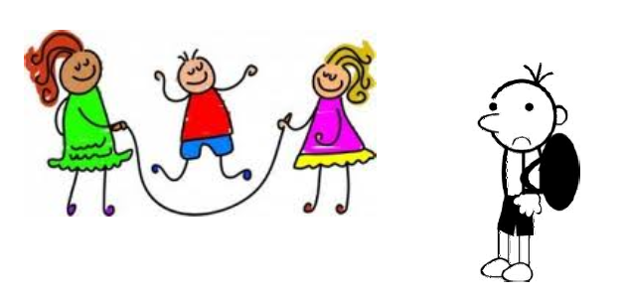
When this happens, my friends won’t want to play with me. This will make me sad because I like playing games.

Slide 8
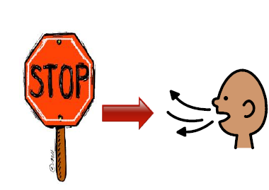
When I lose, I need to STOP, take a deep breath and think, ‘it’s ok to lose’.

Slide 9
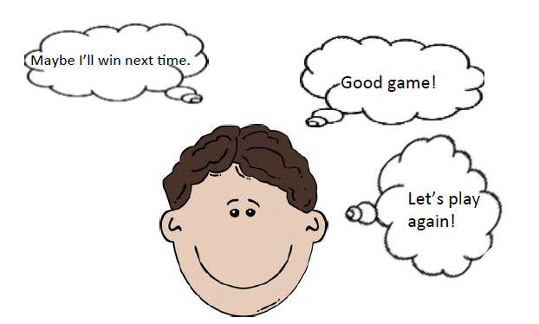
I will say, ‘maybe I’ll win next time’. I can tell my friends ‘good game!’, ‘that was fun!’ and ‘let’s play again!’

Slide 10
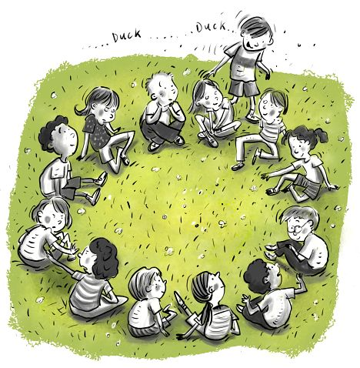
Sometimes I don’t get chosen when playing a game. This also makes me feel sad and sometimes angry.

Slide 11
When I don’t get chosen, I need to STOP, take a deep breath and think, ‘it’s ok to not be chosen this time’.

Slide 12
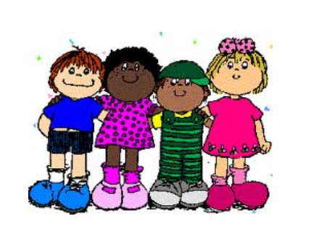
This makes my friends feel happy and they will want to play with me again.

Slide 13
It makes me feel happy when my friends want to play with me.

