Slide 1
JAM
Testing

Slide 4
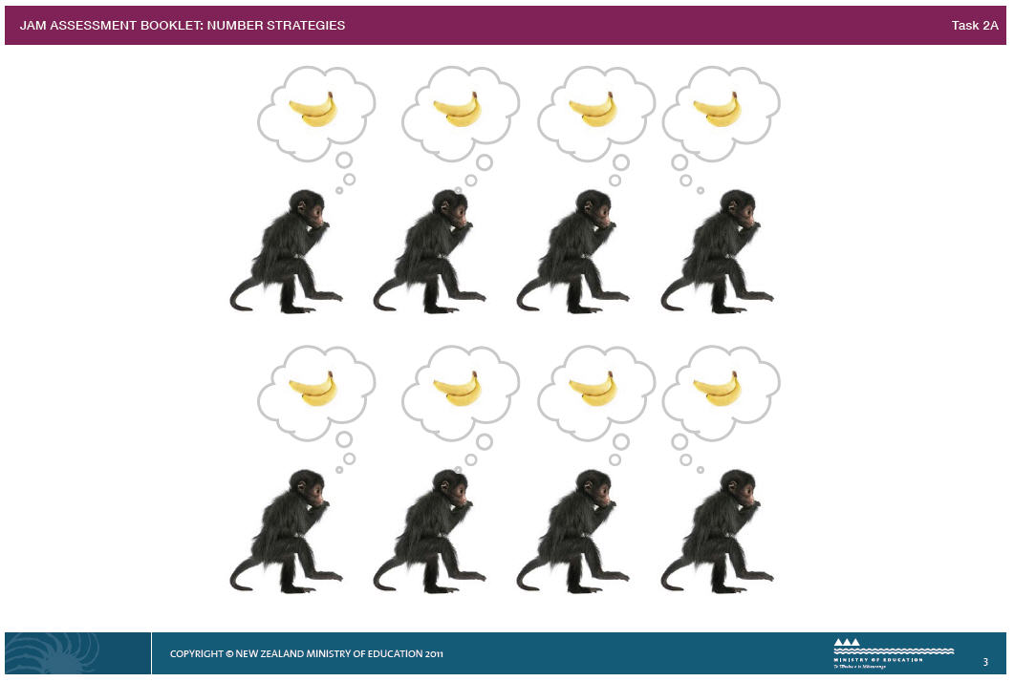

Slide 5
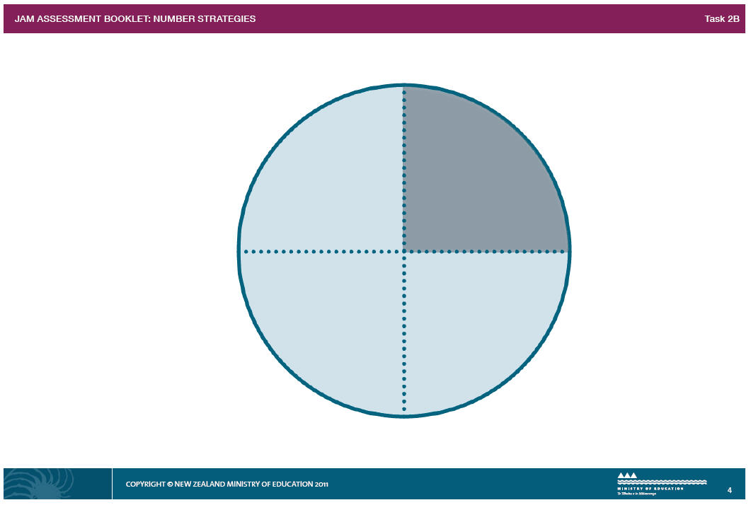

Slide 7
MODULE 3: NUMBER IDENTIFICATION
3

Slide 8
MODULE 3: NUMBER IDENTIFICATION
9

Slide 9
MODULE 3: NUMBER IDENTIFICATION
5

Slide 10
MODULE 3: NUMBER IDENTIFICATION
1

Slide 11
MODULE 3: NUMBER IDENTIFICATION
8

Slide 12
MODULE 3: NUMBER IDENTIFICATION
6

Slide 13
MODULE 3: NUMBER IDENTIFICATION
0

Slide 14
MODULE 3: NUMBER IDENTIFICATION
4

Slide 15
MODULE 3: NUMBER IDENTIFICATION
2

Slide 16
MODULE 3: NUMBER IDENTIFICATION
7

Slide 17
MODULE 3: NUMBER IDENTIFICATION
13

Slide 18
MODULE 3: NUMBER IDENTIFICATION
19

Slide 19
MODULE 3: NUMBER IDENTIFICATION
11

Slide 20
MODULE 3: NUMBER IDENTIFICATION
16

Slide 21
MODULE 3: NUMBER IDENTIFICATION
12

Slide 22
MODULE 3: NUMBER IDENTIFICATION
66

Slide 23
MODULE 3: NUMBER IDENTIFICATION
43

Slide 24
MODULE 3: NUMBER IDENTIFICATION
80

Slide 25
MODULE 3: NUMBER IDENTIFICATION
38

Slide 26
MODULE 3: NUMBER IDENTIFICATION
137

Slide 27
MODULE 3: NUMBER IDENTIFICATION
463

Slide 28
MODULE 3: NUMBER IDENTIFICATION
695

Slide 29
MODULE 3: NUMBER IDENTIFICATION
702

Slide 30
MODULE 3: NUMBER IDENTIFICATION
899

Slide 31
MODULE 4: NUMBER FORWARD SEQUENCE KNOWLEDGE
1

Slide 32
MODULE 4: NUMBER FORWARD SEQUENCE KNOWLEDGE
9

Slide 33
MODULE 4: NUMBER FORWARD SEQUENCE KNOWLEDGE
3

Slide 34
MODULE 4: NUMBER FORWARD SEQUENCE KNOWLEDGE
7

Slide 35
MODULE 4: NUMBER FORWARD SEQUENCE KNOWLEDGE
13

Slide 36
MODULE 4: NUMBER FORWARD SEQUENCE KNOWLEDGE
11

Slide 37
MODULE 4: NUMBER FORWARD SEQUENCE KNOWLEDGE
19

Slide 38
MODULE 4: NUMBER FORWARD SEQUENCE KNOWLEDGE
76

Slide 39
MODULE 4: NUMBER FORWARD SEQUENCE KNOWLEDGE
29

Slide 40
MODULE 4: NUMBER FORWARD SEQUENCE KNOWLEDGE
99

Slide 41
MODULE 4: NUMBER FORWARD SEQUENCE KNOWLEDGE
378

Slide 42
MODULE 4: NUMBER FORWARD SEQUENCE KNOWLEDGE
149

Slide 43
MODULE 4: NUMBER FORWARD SEQUENCE KNOWLEDGE
794

Slide 44
MODULE 4: NUMBER FORWARD SEQUENCE KNOWLEDGE
409

Slide 45
MODULE 4: NUMBER FORWARD SEQUENCE KNOWLEDGE
999

Slide 46
MODULE 5: NUMBER BACKWARD SEQUENCE KNOWLEDGE
4

Slide 47
MODULE 5: NUMBER BACKWARD SEQUENCE KNOWLEDGE
9

Slide 48
MODULE 5: NUMBER BACKWARD SEQUENCE KNOWLEDGE
6

Slide 49
MODULE 5: NUMBER BACKWARD SEQUENCE KNOWLEDGE
8

Slide 50
MODULE 5: NUMBER BACKWARD SEQUENCE KNOWLEDGE
13

Slide 51
MODULE 5: NUMBER BACKWARD SEQUENCE KNOWLEDGE
11

Slide 52
MODULE 5: NUMBER BACKWARD SEQUENCE KNOWLEDGE
20

Slide 53
MODULE 5: NUMBER BACKWARD SEQUENCE KNOWLEDGE
80

Slide 54
MODULE 5: NUMBER BACKWARD SEQUENCE KNOWLEDGE
30

Slide 55
MODULE 5: NUMBER BACKWARD SEQUENCE KNOWLEDGE
100

Slide 56
MODULE 5: NUMBER BACKWARD SEQUENCE KNOWLEDGE
261

Slide 57
MODULE 5: NUMBER BACKWARD SEQUENCE KNOWLEDGE
576

Slide 58
MODULE 5: NUMBER BACKWARD SEQUENCE KNOWLEDGE
400

Slide 59
MODULE 5: NUMBER BACKWARD SEQUENCE KNOWLEDGE
230

Slide 60
MODULE 5: NUMBER BACKWARD SEQUENCE KNOWLEDGE
1000

Slide 61
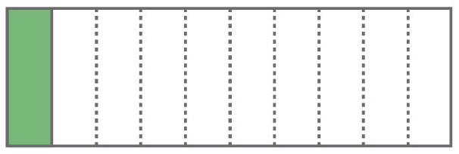
MODULE 6: NUMBER FRACTION KNOWLEDGE

Slide 62
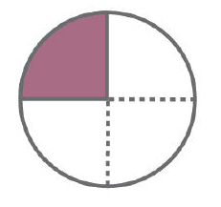
MODULE 6: NUMBER FRACTION KNOWLEDGE

Slide 63
MODULE 6: NUMBER FRACTION KNOWLEDGE

Slide 64
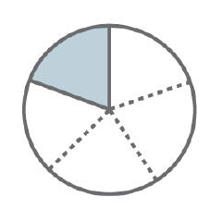
MODULE 6: NUMBER FRACTION KNOWLEDGE

Slide 65
MODULE 6: NUMBER FRACTION KNOWLEDGE

Slide 66
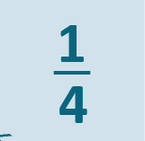
MODULE 6: NUMBER FRACTION KNOWLEDGE

Slide 67
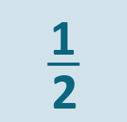
MODULE 6: NUMBER FRACTION KNOWLEDGE

Slide 68
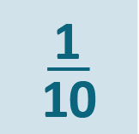
MODULE 6: NUMBER FRACTION KNOWLEDGE

Slide 69
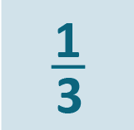
MODULE 6: NUMBER FRACTION KNOWLEDGE

Slide 70
MODULE 6: NUMBER FRACTION KNOWLEDGE

Slide 71
MODULE 6: NUMBER FRACTION KNOWLEDGE

Slide 72
MODULE 7: NUMBER GROUPING PV KNOWLEDGE

Slide 73
MODULE 7: NUMBER GROUPING PV KNOWLEDGE

Slide 74
MODULE 7: NUMBER GROUPING PV KNOWLEDGE

Slide 75
MODULE 7: NUMBER GROUPING PV KNOWLEDGE

Slide 76
MODULE 7: NUMBER GROUPING PV KNOWLEDGE

Slide 77
MODULE 7: NUMBER GROUPING PV KNOWLEDGE

Slide 78
MODULE 7: NUMBER GROUPING PV KNOWLEDGE

Slide 79
MODULE 7: NUMBER GROUPING PV KNOWLEDGE

Slide 80
MODULE 7: NUMBER GROUPING PV KNOWLEDGE

Slide 81
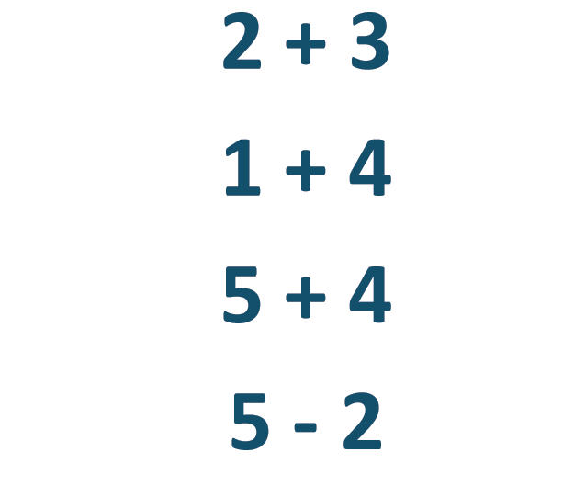
MODULE 8: NUMBER BASIC FACTS

Slide 82
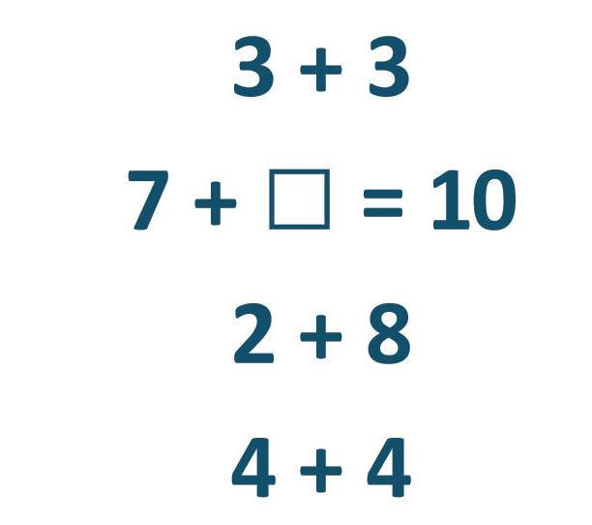
MODULE 8: NUMBER BASIC FACTS

Slide 83
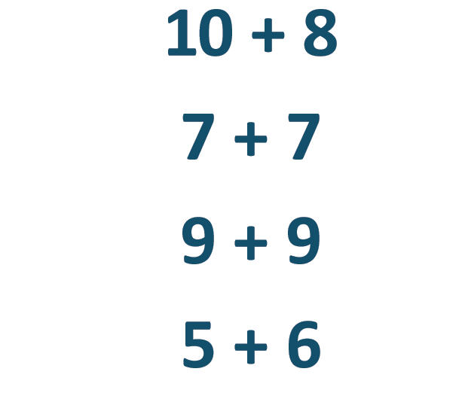
MODULE 8: NUMBER BASIC FACTS

Slide 84
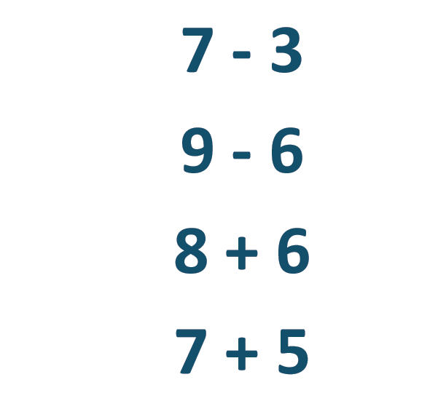
MODULE 8: NUMBER BASIC FACTS

