Slide 1
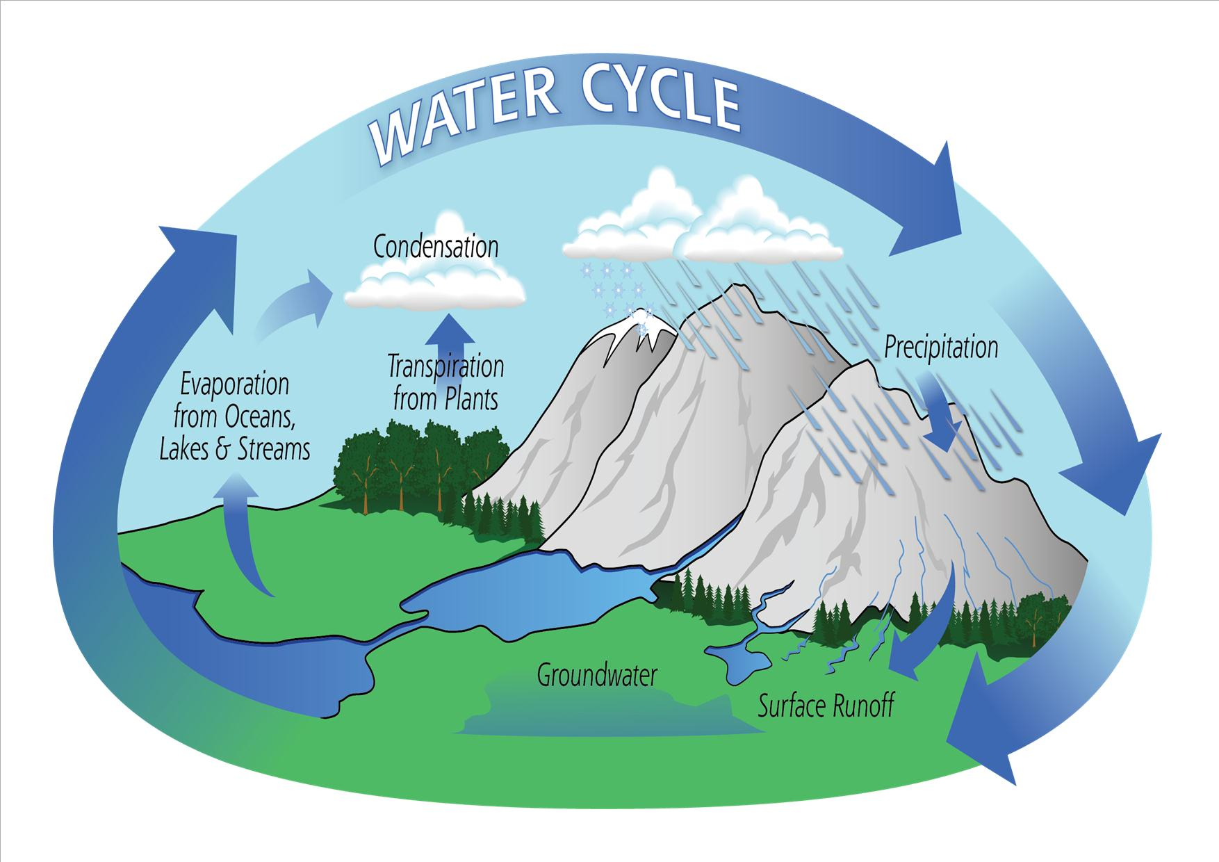
GLUG AND THE WATER CYCLE

Slide 2
Once upon a time, there was a little drop of water called Glug, who lives in a river. Even though she didn’t know it, she had a very important mission on Earth, and that was in the cycle of water.

Slide 3
Glug was a very young water drop so she didn’t know why her mother would often leave the river and return a few days later.

Slide 4
So one morning when the sun was shining brightly, Glug asked: “Mum, why do you leave the river sometimes?” Her mother answered: “Well, because we water drops have a very important job to do: we must ensure that the cycle of water continues.”

Slide 5
Glug was very surprised, for she had never imagined that her mother was so important to Earth. However, Glug wasn’t very sure exactly what this mission actually was, so she asked:

Slide 6
So what’s the important mission, Mum?”
“It’s not just my mission, but yours too, and all the water drops on Earth.”
Glug was open-mouthed, for she too was part of this important mission for the planet.

Slide 7
Her mother continued: “We water drops rest in the rivers, seas, lakes, etc. But on sunny days, we must evaporate in order to form clouds. Once we are in the air in a cloud and it becomes colder, we weigh too much for it, and the cloud lets go of all the water, producing what we call rain.

Slide 8
Then the rain waters the fields and plants, and allows the rivers and seas to be refilled, so that all living beings have water to drink. This is the water cycle, and there is life on Earth because of it.”

Slide 9
And that was how Glug, the little drop of water, learned that it is thanks to her and all the other water drops that the water cycle is possible on Earth.

Slide 10
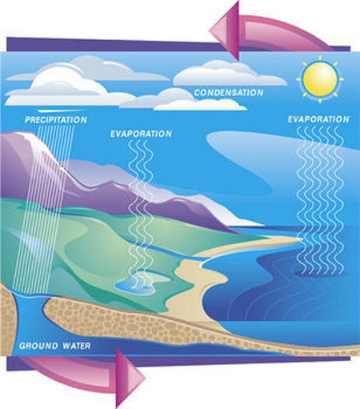

Slide 11
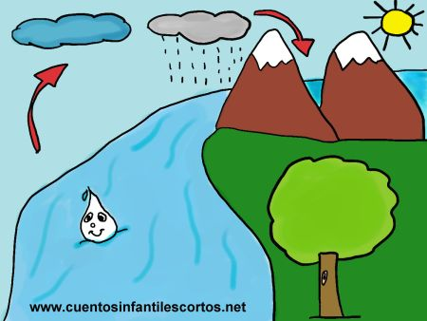

Slide 12
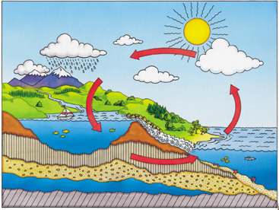
Label the diagram with the correct words

Slide 13
http://www.youtube.com/watch?v=Z0ymnkj8N-U

Slide 14
Important words we need to learn and remember.
Sun
Wind
Snow
Rain
Sea
Rivers
Stream
Lake
Ocean
Evaporation
Ground run off
Condensation

