Slide 1
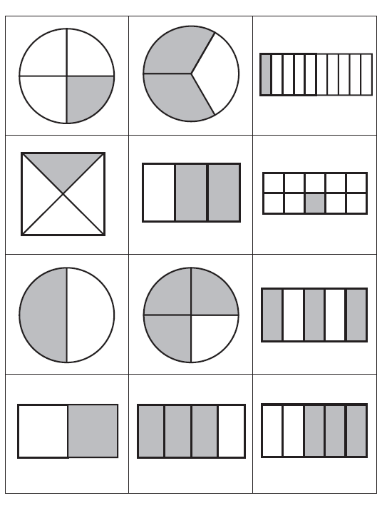
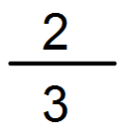
Write the Fraction for each shaded question
Steps to Success:
Look at the bottom number of the fraction and make that number of groups.
Share out the counters equally until they are gone
Look at the top number and count the number of counters in that many groups.
1
Of 12=
Of 18=
9
1
1
Of 16=
Of 20=
4
4
1
2
Of 15=
Of 18=
5
6
2
1
Of 15=
Of 18=
3
3
1
1
Of 21=
Of 25=
7
5
2
1
Of 30=
Of 16=
8
6

Slide 2
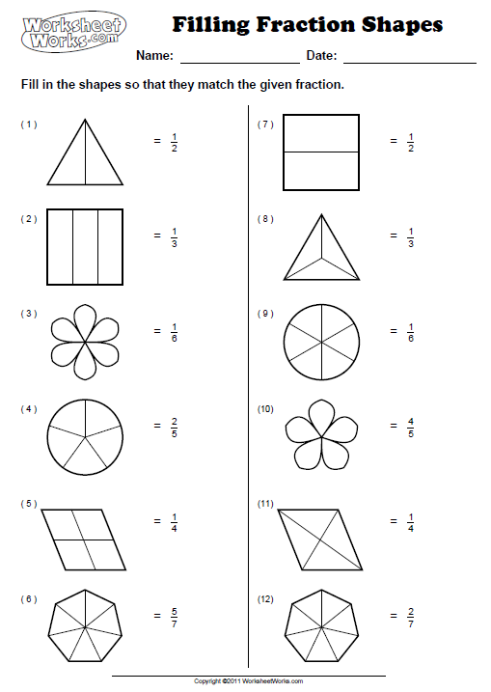
Colour the Fraction for each question
Steps to Success:
Look at the bottom number of the fraction and make that number of groups.
Share out the counters equally until they are gone
Look at the top number and count the number of counters in that many groups.
5
Of 15=
Of 18=
9
1
3
Of 8=
Of 20=
4
4
1
3
Of 20=
Of 18=
5
6
2
2
Of 24=
Of 18=
3
3
3
4
Of 21=
Of 25=
7
5
4
5
Of 30=
Of 16=
8
6

