Slide 1
Back to school
Ideas to share...
Let's make the start of the year magic for all...
This work is licensed under a Creative Commons Attribution Noncommercial Share Alike 3.0 License.

Slide 2
Feather Pillow story - by CaroBush
A very abridged version of a story adapted from an old Jewish folk tale.
A teacher was walking home past a fruit shop, he stopped, chose a large juicy apple from the barrel at the front and carried on his way without stopping to pay.
He was seen by a student who proceeded to share with his classmates who in turn told their parents that he had seen the teacher steal the apple from the shop. When very few turned up to class the following the week the teacher was concerned and questioned the student. The student told the teacher that many parents didn't want their child taught by a thief. The teacher took the child to the fruit shop where the owner explained to the child that the teacher paid his account weekly, including a large juicy apple that he would choose on his way home as he passed the shop. The child was very sorry that he had spread the tale about the teacher asked how he could make it up to him. The teacher asked that he bring a feather pillow to the field the following day. When the child turned up with the pillow the teacher asked that he cut the pillow open and shake the feathers out. Thinking this a very simple punishment the child did as he was told. When he had completed his task he looked to the teacher for further direction.
This work is licensed under a Creative Commons Attribution Noncommercial Share Alike 3.0 License.

Slide 3
Start the year by taking class to the field with a feather pillow - allow them to spread the feathers far and wide. Take many photos for collage, slideshow or blogging. Share the story above and reflect on the impact of our words....
This work is licensed under a Creative Commons Attribution Noncommercial Share Alike 3.0 License.

Slide 4
Collaborative art work - or collage - or ... that every kid/adult who works in the class has a part of ...
This work is licensed under a Creative Commons Attribution Noncommercial Share Alike 3.0 License.

Slide 5
Banner for the wall:-
Buy rolls of white paper from Newspaper Office
Measure out length of wall - allow the whole class to draw themselves across the page - dye and add individual face photos - display by the end of day one!
Anne K

Slide 6
QR Code Treasure Hunt Generator
A generator that creates the QR codes for your treasure hunt. You must put in at least 5 questions and answers and click create! What a way to start the year!

Slide 7
Class Treaty
Read the treehouse treaty! Create your own class treaty! I love John Nottingham's idea of class and school attitudes as opposed to class and school rules.
Personalise the agreement by adding thumbprint and signatures.
The Treaty of Waitangi -
3 Ps = Partnership, Participation and Protection.
Anne K

Slide 8
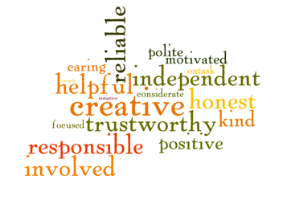
Creating a class culture
Students write their 5 words which describe which values they most admire.
Use wordle to illustrate top 5 most valued.
Put in sidebar of your
blog or front page of
your wiki.
Print out and laminate
to refer back to.

Slide 9
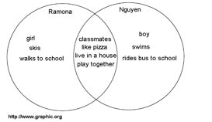
Getting to know you! Draw names out of a hat and get students to use a venn diagram to find same / different
Then interview each other (5 things you don't know about me) and take a series of photos to present information in a Photostory / PPT or similar. Post on class blog or wiki. Key Competency - Relating to Others

Slide 10
Right from the beginning talk about the effects of bullying on others- set a culture of supportive collegiality. This simulation is excellent.
alogy-for-students.htmlhttp://www.edgalaxy.com/journal/2011/11/23/great-bullying-an
AllanahK

Slide 11
Create Class Heroes - Who do I want to be this year? Or Design your own Super Hero here. What qualities and attributes do we want in our class?
http://moturoa.blogspot.com/2011/12/google-presentation-super-powers.html
Create a Google Earth Map with where students went in the holidays, add a Pin and information about things to do in that area

Slide 12
Roster students to take digital camera home to photograph their favourite things. Prepare a presentation to talk to "About me".
Limit number of slides and time - pecha kucha style
(Sneaky introductions to speeches, if required)

Slide 13
Kete of learning
Read Journal story about responsibility for gathering the knowledge into our own kete.
2004 Pt3, No 1 The three kete by Sue Gibbison
3 Kete on the wall - children write on Kete outline and add to each kete each day until it becomes habit!
Te Kete Tuatea – The Kete of Mental and Physical Challenges
Te Kete Aronui – The Kete of Emotions
Te Kete Tuauri – The Kete of Prayer
Excellent for independence, balance, reflection,
Anne K

Slide 14
Kids as teachers
Kids as teachers - we need to create independent learners but how can we do this when we are taking reading groups / maths groups etc. Teach one or two of your students and make them the Experts in a particular piece of software, using the camera, saving work, etc. Remember to teach them to be helpers and not the doers. Create an experts wall so there is a visual reminder for students to know where to get help. Share the roles around.

Slide 15
Sourced from: - Cheat Sheet on the first day of school
1) Develop an easy slogan for expectations in your classroom.
Having a slogan that everyone can remember will remind kids of the rules you clearly set in the beginning of the school year. Few of us (teachers included) look up at the rules and cite them in our punishment. Most teachers have a general guideline of behaviors that we expect and pull up quickly when a student has crossed a certain line. For instance, my slogan is usually founded on respect: i.e., "Respect yourself, respect me and respect each other." Most of the rules we live by in the classroom follow in more detail. I rarely have to look up at the rules, because the kids remember the word "respect" and, for that matter, "disrespectful."

Slide 16
Have students select a quote that best depicts them / their ambitions / their goals / values
Take a photo that will illustrate that to accompany it.

Slide 17
Make a video trailer
Ideas here for creating video

Slide 18
Links to More Ideas
Some ideas here
Edmodo ideas for back to school
We are all learning ICT bingo
Regulating the yelling - some good lessons here for self managing
What I won't do on the first day of school
Classroom Posters - Some good ideas here for students to create posters

Slide 19
10 GREAT ACTIVITIES TO BREAK THE ICE WITH YOUR STUDENTS
Class Badges - customise badges for motivation
Teach Search
What's Your Sentence?
Techy Icebreakers
10 tips for creating a class environment - @whatedsaid

Slide 20
Digital Citizenship
Check out this amazing resource!
What could you add to your programme as you start the year…

Slide 22
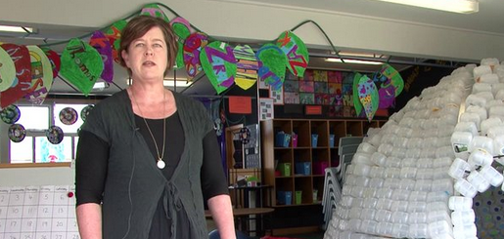
Get creative with learning spaces!
http://teacherswithapps.com/21st-century-challenging-learning-spaces/
How about let your learners design their own learning spaces?

Slide 23
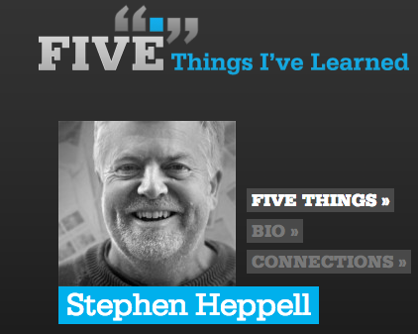
Fabulous place to start when thinking about the new year...

Slide 24
#bloggingmeme via @abfromz who tagged me.
Encourages writing on blogs and getting to know each other.
Encourages giving feedback on blogs.
The blogging task includes:
Acknowledge the nominating blogger.
Share 11 random facts about yourself.
Answer the 11 questions the nominating blogger has created for you.
List 11 bloggers.
Post 11 questions for the bloggers you nominate to answer, and let all the bloggers know they have been nominated. Don’t nominate a blogger who has nominated you.
Finally join the #quadblogging group via the VLN
http://www.vln.school.nz/groups/profile/806819/quadblogging-aotearoa
Sonya @vanschaijik 6/01/14

Slide 25
Photocopy 30 puzzle pieces and get each student to take a selfie and write 5 fun facts to go with their piece. Have them colour/paint/dye/decorate their whole piece. Then create a huge puzzle by putting the pieces on display. Talk about how we ‘fit’ together as a class, we come in as individual pieces and we can still be individuals but together we make a great picture!
@krivett1

Slide 26
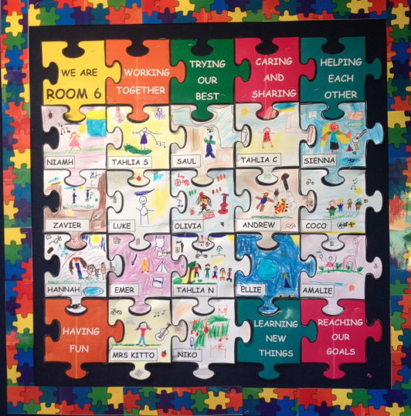
The previous slide has an explanation about a class puzzle. Here is an example of what my year 1&2 class made last year. The children drew themselves in the middle of the puzzle piece and around the outside they drew things that they enjoyed doing.
@StephKitto1

Slide 27
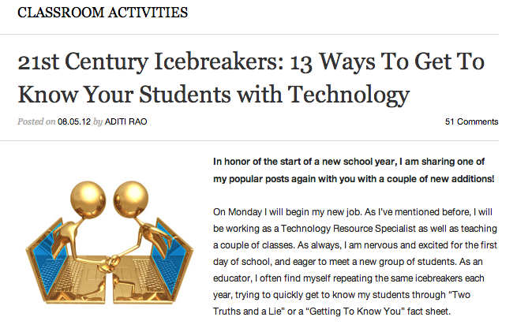

Slide 28
Wait till the second week before giving out course statements
Before deciding what Achievement Standards you are going to deliver, find out who your students are, what they are interested in.
Design a course with them in mind. Is there an authentic context or theme you can use to help with assessments to make them interesting/engaging.

Slide 29
Things to go over...
What is the purpose of your course?
What is important and therefore worth spending time on?
Who am I trying to attract?
By selecting this course, what will be the learning outcomes for students?
(hint: use the Curriculum/body of knowledge material)
Notes:
Be clear what the course is for and what skills the students will acquire
Have a look at - The New Zealand Curriculum, Page 3, Teaching as Inquiry
And remember the 3 C’s - Clear Pathways - Coherency - Consistency

Slide 30
Have you looked at POND?
www.pond.co.nz is a great place to go to search for resources that teachers use in their classrooms, you might find a resourse or learning ideas that could assist with a unit that you are planning.
Share your thoughts and if you like it give it a Ka Pai!

Slide 31
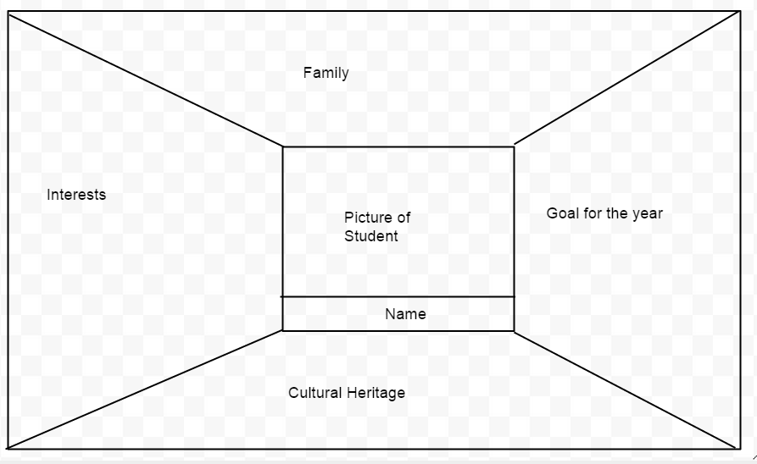
Class Quilt:
This is just a rough template and the words/ themes for each square could easily be changed to whatever you want the students to draw about. The idea is that the whole class completes one and it goes up on the wall, side by side like a quilt.
@andy_s_crowe

Slide 32
Birthday Cards
One activity I usually do is to give my new class art and craft resources and get them to make a generic Happy Birthday card.
The children decorate the card and write a general message inside such as 'Happy Birthday from all your friends in Room 11.'
Then throughout the year when it a child's birthday they get to choose one of the cards out of a box.
The children really like the idea and love it when someone chooses their card.
@hkkh18

Slide 33
Sharing of Personal Kete
Letter sent home to each student prior to school starting….
We would like you to prepare a kete of personal items that expresses something about yourself. Your kete will help your teachers and classmates understand a bit more about your personality. Choose a favourite bag or container to keep your personal belongings in. Include no more than 6 items, e.g. photo, book, trophy, medal, special card or letter, baseball glove, rugby jersey, trinket, toy, game, etc. You will be rostered to share your kete, so you do not need to bring it to school until your sharing day; however it will be great to have it ready to go.
@hkkh18
Notes:
Setting Up with

Slide 34
Junior School - Nga Mihi
Begin the year by introducing yourself in Maori. Put the images into i-Movie and record the children introducing themselves. The movie can be uploaded onto your class blog and the artwork makes a great week 1 display.
@StephKitto1

